Slide 1
MACHINE LEARNING IN FINANCE
AMISHA ASRANI
ENG19CS0029

Slide 2
What is Machine Learning (in Finance)?
Machine learning is a subset of data science that provides the ability to learn and improve from experience without being programmed.
Machine learning is making significant inroads in the financial services industry.
Machine learning in finance is now considered a key aspect of several financial services and applications, including managing assets, evaluating levels of risk, calculating credit scores, and even approving loans.
Let’s see why financial companies should care, what solutions they can implement with AI and machine learning, and how exactly they can apply this technology.

Slide 3
As an application of artificial intelligence, machine learning focuses on developing systems that can access pools of data, and the system automatically adjusts its parameters to improve experiences. Computer systems run operations in the background and produce outcomes automatically according to how it is trained.
Machine learning tends to be more accurate in drawing insights and making predictions when large volumes of data are fed into the system. For example, the financial services industry tends to encounter enormous volumes of data relating to daily transactions, bills, payments, vendors, and customers, which are perfect for machine learning.
Nowadays, many leading fintech and financial services companies are incorporating machine learning into their operations, resulting in a better-streamlined process, reduced risks, and better-optimized portfolios.

Slide 4
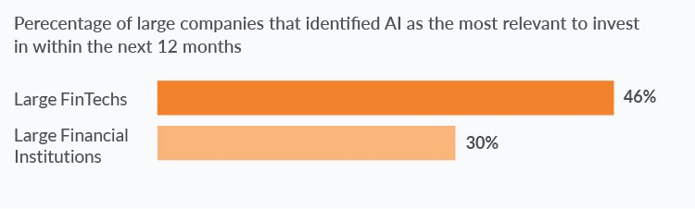
Why consider machine learning in finance?
The figure below shows that financial services’ execs take machine learning very seriously, and they do it for a bunch of good reasons:
Reduced operational costs thanks to process automation.
Increased revenues thanks to better productivity and enhanced user experiences.
Better compliance and reinforced security.
Notes:
There is a wide range of open-source machine learning algorithms and tools that fit greatly with financial data. Additionally, established financial services companies have substantial funds that they can afford to spend on state-of-the-art computing hardware.
Tanks to the quantitative nature of the financial domain and large volumes of historical data, machine learning is poised to enhance many aspects of the financial ecosystem.
That is why so many financial companies are investing heavily in machine learning R&D. As for the laggards, it can prove to be costly to neglect AI and ML.

Slide 5
That said, most financial services companies are still not ready to extract the real value from this technology for the following reasons:
Businesses often have completely unrealistic expectations towards machine learning and its value for their organizations.
R&D in machine learning is costly.
The shortage of DS/ML engineers is another major concern. The figure below illustrates an explosive growth of demand for AI and machine learning skills.
Financial incumbents are not agile enough when it comes to updating data infrastructure.

Slide 6
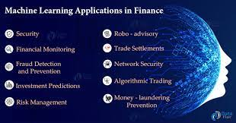

Slide 7
Fraud Detection
According to the Cambridge Dictionary, fraud is “the crime of getting money by deceiving people.” With the development and expansion of e-commerce, fraud has taken on new forms and become more powerful than ever. As the scale of e-shopping, online banking, and online insurance increases, fraudsters take full advantage of every weak spot in every system they can find. Quite often, before professionals can patch up a system, sensitive data is stolen and millions of dollars are lost. Fraud has turned into a major issue and an uncontrolled expenditure for e-commerce retailers on a global level.
Preventing, detecting, and eliminating fraud are some of the primary concerns of the e-commerce and banking industries at present. One of the most promising means for achieving them are machine learning development services.
.

Slide 8
Why use machine learning for fraud detection?
In a nutshell, machine learning (ML) is the science of creating and applying algorithms that are capable of learning from the past. Machine learning finds a perfect use case in fraud detection. Machine learning algorithms learn to tell fraudulent operations from legitimate ones without raising the suspicions of those executing the transactions. Machine learning can fight financial fraud by using big data better and faster than humans ever will be able to.
Fraud detection machine learning models are more effective than humans
The concept behind using machine learning in fraud detection is that fraudulent transactions have specific features that legitimate transactions do not. Based on this assumption, machine learning algorithms detect patterns in financial operations and decide whether a given transaction is legitimate. Machine learning fraud detection algorithms are way more effective than humans. They can process a raft of information faster than a team of the best analysts ever could.

Slide 9
ML beats traditional fraud detection systems
The traditional fraud detection model is based on a static rules-based system, also referred to as a production or expert system. Although these systems have been effective for a long time, some of their major disadvantages make them unsuitable for modern digital environments. A static rules-based system is heavily dependent on human labor. But naturally, top analysts are expensive. And their work takes time. What’s more, even top experts create rules based on their knowledge, skills, and experience, which are always limited. Such rules can grow to enormous sizes and get so complex that it’s nearly impossible for an outsider to understand them when needed. Also, creating a new rule and implementing it takes a while when done by hand.

Slide 10
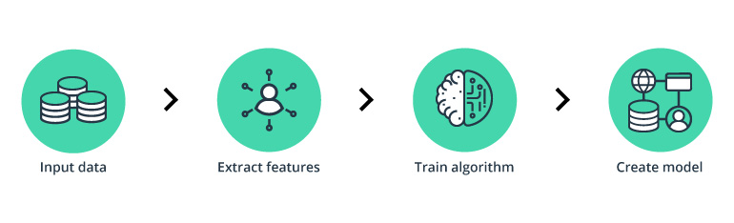
How does machine learning in fraud detection work?
Notes:
To detect fraud, a machine learning model first needs to collect data. The model analyzes all the data gathered, segments, and extracts the required features from it. Next, the machine learning model receives training sets that teach it to predict the probability of fraud. Finally, it creates fraud detection machine learning models.

Slide 11
DATA SET
The dataset contains transactions made by credit cards in September 2013 by European cardholders.
This dataset presents transactions that occurred in two days, where we have 73 frauds out of 15,936 transactions. The dataset is highly unbalanced, the positive class (frauds) account for 0.46% of all transactions.
It contains only numerical input variables which are the result of a PCA transformation. Unfortunately, due to confidentiality issues, we cannot provide the original features and more background information about the data. Features V1, V2, … V28 are the principal components obtained with PCA, the only features which have not been transformed with PCA are 'Time' and 'Amount'. Feature 'Time' contains the seconds elapsed between each transaction and the first transaction in the dataset. The feature 'Amount' is the transaction Amount, this feature can be used for example-dependant cost-sensitive learning. Feature 'Class' is the response variable and it takes value 1 in case of fraud and 0 otherwise.
Given the class imbalance ratio, we recommend measuring the accuracy using the Area Under the Precision-Recall Curve (AUPRC). Confusion matrix accuracy is not meaningful for unbalanced classification.

Slide 12
XGBOOST
“It is the execution of gradient boosted decision trees that is designed for high speed and performance.”XGboost is commonly used for supervised learning in machine learning.
It carries out the gradient boosting decision tree algorithm. It has several different names like gradient boosting, gradient boosting machine, etc.
Boosting is nothing but ensemble techniques where previous model errors are resolved in the new models. These models are added straight until no other improvement is seen. One of the best examples of such an algorithm is the AdaBoost algorithm.
Gradient boosting is a method where the new models are created that computes the error in the previous model and then leftover is added to make the final prediction.
It uses a gradient descent algorithm that is the reason it is called a “Gradient Boosting Algorithm”. Weather classification or regression methods are supported for both types of predictive modelling problems.

Slide 13
Colab-
https://colab.research.google.com/drive/1FvOcaKi45xUjXJPc1onxbNXks3YqqOXa?usp=sharing
Github-
https://github.com/Amisha-A/DL-Seminar.git

